Slide 1
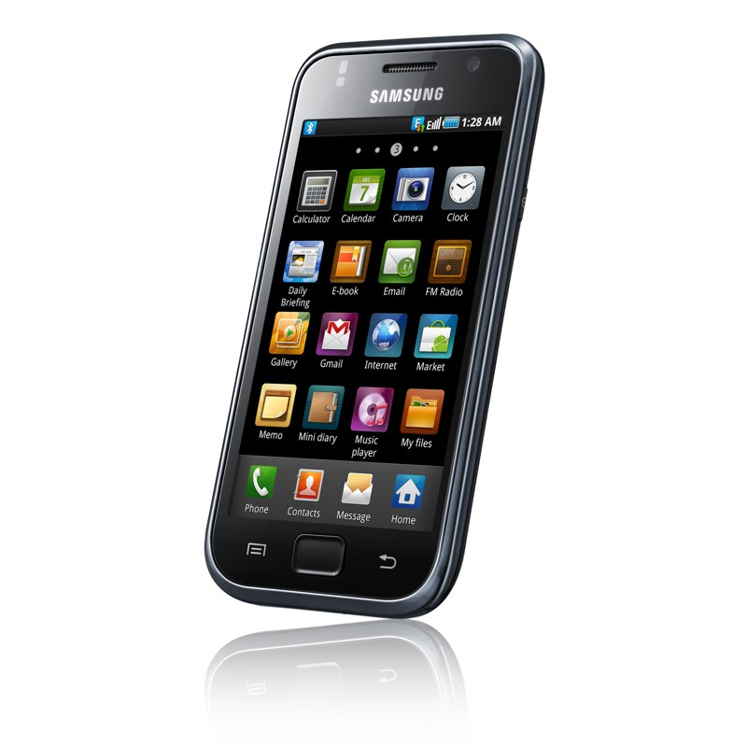

Wi-Fi Matic Android App
High Level Design
Work In Progress
(App Icon in Android devices)
App web site:
https://sites.google.com/site/wifimaticapp/
Google Play (Android Market):
https://play.google.com/store/apps/details?id=org.cprados.wificellmanager
© Carlos Prados 2012, 2013 <wifimatic.app@gmail.com>

Slide 2

Wi-Fi Matic: Application Processes:
Process | Modules | High Level Description
Service Initialization
Events Procesing
User Interface Handling

Slide 3
Wi-Fi Matic. Events Processing. Modules Diagram:
WifiManager
N
ManagerService
M
AuditTrailManager
A
EventReceiver
AlarmManager
C
onStartCommand
B
CellStateListener
TelephonyManager
D
CellStateManager
buildPlan
WifiStateManager
Android
G
F
validatePlan
performPlan
I
manageStateChange
validateAction
performAction
StateMachine
H
M
K
L
J
RequestedActionManager
NotificationManager
MobileDataManager
DataManager
E

Slide 4
Wi-Fi Matic. Events Processing: Interfaces:
Interface | Methods | Description
A | EventReceiver. onReceive | Input: Intent Output: None Responsability: Receives Intents fired by the system and forwards them to the manager service: boot completion, alarm manager periodic alarms (to check cell location while Android is slept), wifi status and connection state changes.
B | CellStateListener. onCellLocationChanged | Input: CellLocation Output: None Responsability: Receives cell location changes and forwards them to the manager service as Intents. Based on PhoneStateListener, only processes Cell Location Change calls when the device is not suspended.
C | Context.startService (intent for ManagerService) | Input: Intent Output: ComponentName Responsability: Handles any intent comming from CellLocation Change, periodic cell location refresh, wifi or connection state change. Analizes intent, extracts an event
 | ManagerService.buildPlan | Input: Intent, Current State Output: Action Plan Responsability: Analizes event

Slide 5
Wi-Fi Matic. State Machine: General State Change
IN
CON
IN
DISC
IN
OFF
ADD
OFF
ADD
ADD
ON
OUT
CON
OUT
DISC
ON
OUT
OFF
ADD
ADD
ADD
OFF
ON*
OFF
ADD
INIT
UNK
CON
UNK
DISC
UNK
OFF
ON*
ON

Slide 6
Wi-Fi Matic. State Machine: Wifi State Change
Deferred off on Connection State Changes (v 1.2)
CRD_OFF
CAD_OFF
CON
DISC
OFF
CAD_OFF
Mobile Data Management (v1.3.3)
DATA_RESTORE
CON
DATA_RESTORE
DISC
OFF
DATA_OFF
DATA_OFF

Slide 7
Wi-Fi Matic. Events model
1 Intent
0..3 StateEvent
0..2 StateAction
StateEvent
StateAction
Intent
StateEvent
StateAction
0..1 RequestedAction
1..1 StateAction
RequestedAction
StateAction

Slide 8

Wi-Fi Matic Audit Trail
<WifiState|StateAction>
<CellState|RequestedAction>
HH:MM
Action: Yes|No
HH:MM
Hours:Minutes
WifiState: OFF
<WifiState|
StateAction>
Wi-Fi on
Wi-Fi off
Connected to %s
Wi-Fi location remmembered
Activating Wi-Fi
Deactivating Wi-Fi
WifiState: DISC
WifiState: CON
<CellState|
RequestedAction>
Near one Wi-Fi network
Near % Wi-Fi networks
Out of Wi-Fi reach
Scheduled Wi-Fi activation
Scheduled Wi-Fi deactivation
After %d seconds of disconnection
Week day DD/MM/YYYY

